Slide 1
Neural Networks
David Quigley
CSCI 4622
2022 Spring

Slide 2

Course Logistics
Problem Set 3: 3/14 @ 11:59PM
Project Milestone 2 Class Feedback Process Occurring
Most everyone has their course staff feedback + grade
Due 2/28 – but do it earlier!
Exam 1: 3/7
Remote Status TBD – check Canvas / email notifications daily
Remote access is always available – it’s a good default

Slide 3
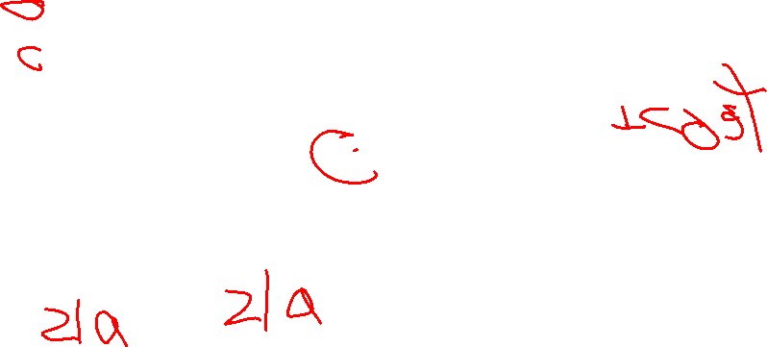
Where We Are
1
1
b¹
b²
Feed-Forward Neural Network
Initialize Weights
SGD loop (for random example):
forward propagate for activations
backward propagate for derivatives
update weights
Y₁
X₁
Y₂
X₂
W¹
W²

Slide 4
Outstanding Issues with Neural Networks
Starting Values
Standard SGD Issues – Local vs. Global Minimum
Stopping Point

Slide 5
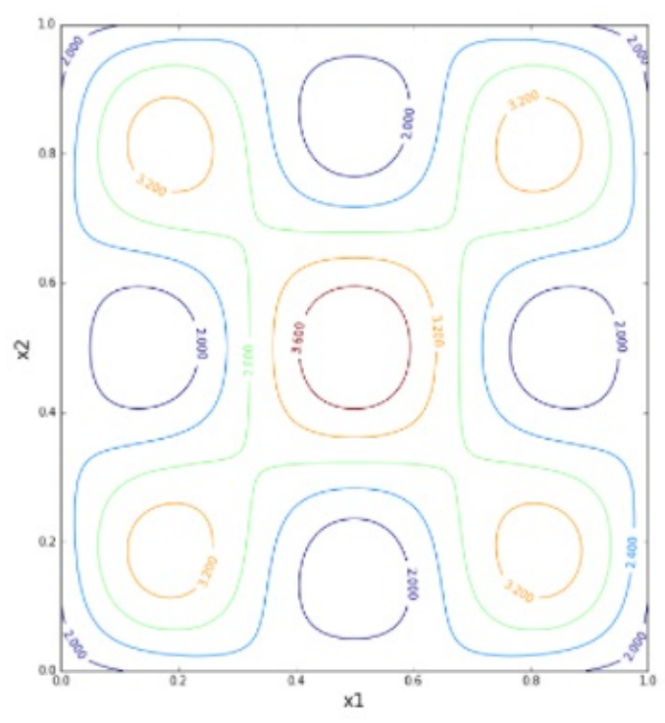

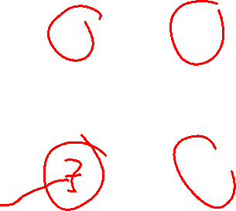
Neural Networks – Convex Function?
1
1
b¹
b²
Local vs. Global Minimum?
Y₁
X₁
Y₂
X₂
W¹
W²

Slide 6
Neural Networks – Overcoming Local Minimum
Multiple training iterations
Initialize with different random variables
Add a noise term to weights
Weights fluctuate even without gradient
Momentum
Increase weight adjustment rate
1
1
b¹
b²
Y₁
X₁
Y₂
X₂
W¹
W²

Slide 7

Neural Networks – Initializing Weights
1
1
b¹
b²
Initialize with all 0s?
Locks Up
Initialize with all 1s?
Works fine…
Initialize with small random weights?
Works better…
Y₁
X₁
Y₂
X₂
W¹
W²

Slide 8
Neural Networks – Weight Explosions
1
1
b¹
b²
How do we combat weights growing out of control?
Y₁
X₁
Y₂
X₂
W¹
W²

Slide 9
Neural Networks – Weight Explosions
1
1
b¹
b²
How do we combat weights growing out of control?
Regularization
L2-Norm
$$C=C_{0}+\frac{\text{λ}}{2}\sum_{w}{w^{2}}$$
L1-Norm
$$C=C_{0}+\frac{\text{λ}}{2}\sum_{w}{w^{1}}$$
Y₁
X₁
Y₂
X₂
W¹
W²

Slide 10
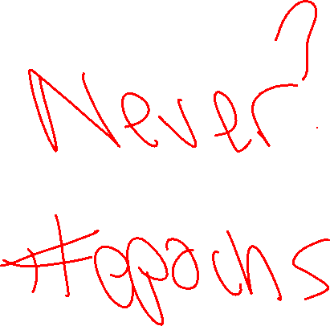
Neural Networks – Stopping Point
1
1
b¹
b²
Y₁
X₁
Y₂
X₂
W¹
W²

Slide 11
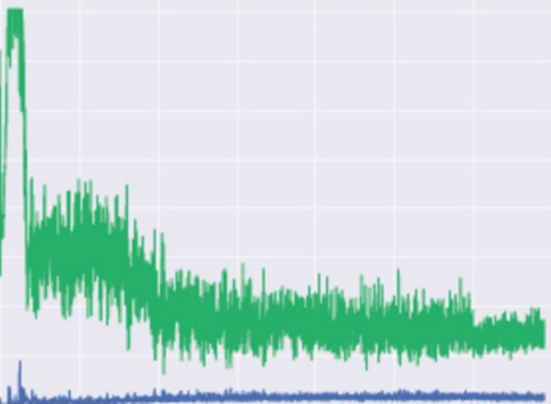
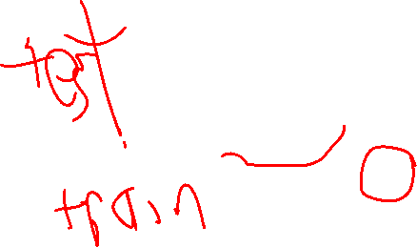
Neural Networks – Stopping Point
1
1
b¹
b²
Same as any SGD Problem, stop when accuracy on validation set stops improving, or at some sort of threshold.
Y₁
X₁
Y₂
X₂
W¹
W²

Slide 12
Convolutional Neural Networks

Slide 13
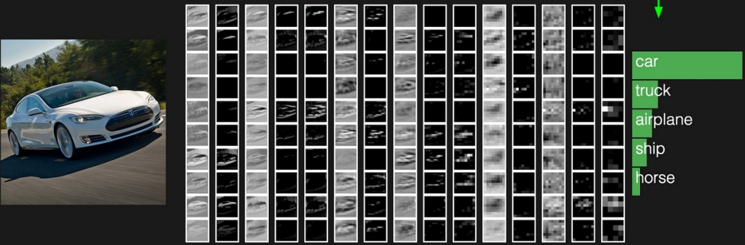
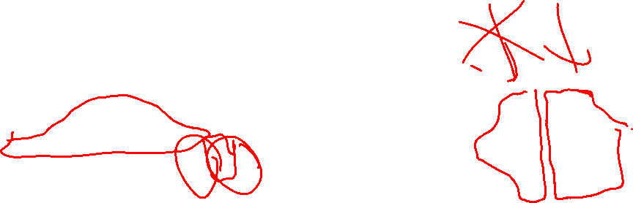
Neural Network – Object Recognition

Slide 14
Basic Feed-Forward Neural Networks
1
1
b¹
b²
Every element of a layer is connected to every element of the following layer
X₂
Y₁
X₁
Y₂
W¹
W²

Slide 15
Basic Feed-Forward Neural Networks
1
1
b¹
b²
Every element of a layer is connected to every element of the following layer
Ordering, neighboring doesn’t matter…
Y₁
X₁
Y₂
X₂
W¹
W²

Slide 16
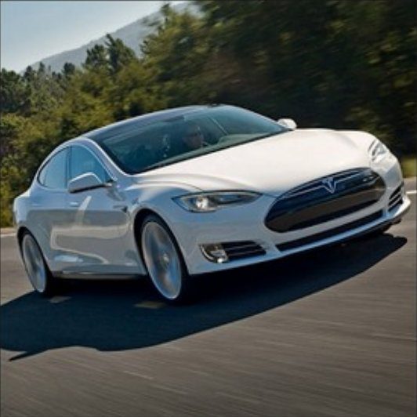
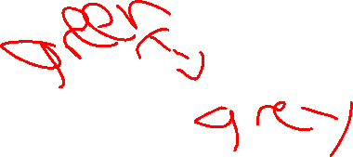

Slide 17
Convolution – CV in 15 minutes
Mathematically combining nearby info
Found in Signals Processing / Computer Vision

Slide 18
Convolution
Initial Matrix
20 | 20 | 45 | 200
18 | 20 | 125 | 240
35 | 125 | 245 | 245
145 | 250 | 240 | 240

Slide 19
Convolution
Initial Matrix
Convolution Matrix
20 | 20 | 45 | 200
18 | 20 | 125 | 240
35 | 125 | 245 | 245
145 | 250 | 240 | 240
1 | 0 | 1
0 | 1 | 0
1 | 0 | 1

Slide 20
Convolution
Initial Matrix
Convolution Matrix
20 | 20 | 45 | 200
18 | 20 | 125 | 240
35 | 125 | 245 | 245
145 | 250 | 240 | 240
1 | 0 | 1
0 | 1 | 0
1 | 0 | 1

Slide 21
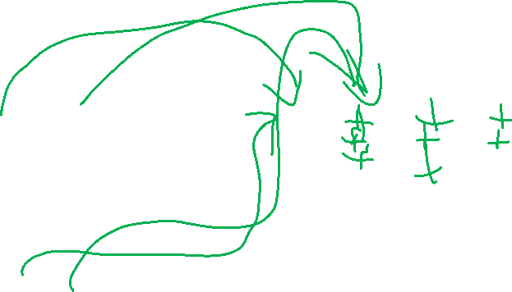
Convolution
Initial Matrix Output Matrix
Convolution Matrix
20 | 20 | 45 | 200
18 | 20 | 125 | 240
35 | 125 | 245 | 245
145 | 250 | 240 | 240
$$\begin{matrix}\left(0,0\right)∗1 & \left(0,1\right)∗0 & \left(0,2\right)∗1 \\ \left(1,0\right)∗0 & \left(1,1\right)∗1 & \left(1,2\right)∗0 \\ \left(2,0\right)∗1 & \left(2,1\right)∗0 & \left(2,2\right)∗1\end{matrix}$$
1 | 0 | 1
0 | 1 | 0
1 | 0 | 1

Slide 22
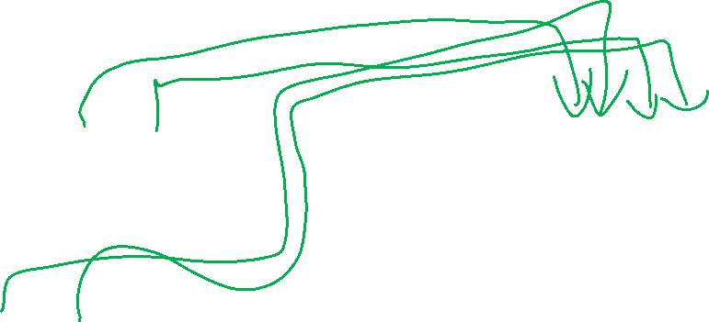
Convolution
Initial Matrix Output Matrix
Convolution Matrix
20 | 20 | 45 | 200
18 | 20 | 125 | 240
35 | 125 | 245 | 245
145 | 250 | 240 | 240
$$\begin{matrix}\left(0,0\right)∗1 & \left(0,1\right)∗0 & \left(0,2\right)∗1 \\ \left(1,0\right)∗0 & \left(1,1\right)∗1 & \left(1,2\right)∗0 \\ \left(2,0\right)∗1 & \left(2,1\right)∗0 & \left(2,2\right)∗1\end{matrix}$$ | $$\begin{matrix}\left(0,1\right)∗1 & \left(0,2\right)∗0 & \left(0,3\right)∗1 \\ \left(1,1\right)∗0 & \left(1,2\right)∗1 & \left(1,3\right)∗0 \\ \left(2,1\right)∗1 & \left(2,2\right)∗0 & \left(2,3\right)∗1\end{matrix}$$
1 | 0 | 1
0 | 1 | 0
1 | 0 | 1

Slide 23
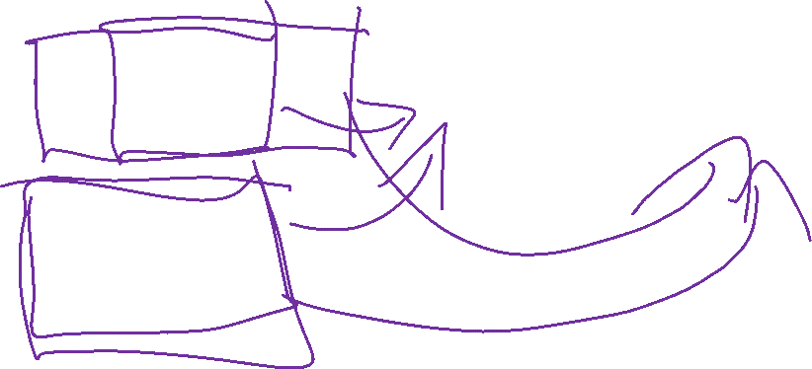
Convolution
Initial Matrix Output Matrix
Convolution Matrix
20 | 20 | 45 | 200
18 | 20 | 125 | 240
35 | 125 | 245 | 245
145 | 250 | 240 | 240
$$\begin{matrix}\left(0,0\right)∗1 & \left(0,1\right)∗0 & \left(0,2\right)∗1 \\ \left(1,0\right)∗0 & \left(1,1\right)∗1 & \left(1,2\right)∗0 \\ \left(2,0\right)∗1 & \left(2,1\right)∗0 & \left(2,2\right)∗1\end{matrix}$$ | $$\begin{matrix}\left(0,1\right)∗1 & \left(0,2\right)∗0 & \left(0,3\right)∗1 \\ \left(1,1\right)∗0 & \left(1,2\right)∗1 & \left(1,3\right)∗0 \\ \left(2,1\right)∗1 & \left(2,2\right)∗0 & \left(2,3\right)∗1\end{matrix}$$
… | …
1 | 0 | 1
0 | 1 | 0
1 | 0 | 1

Slide 24
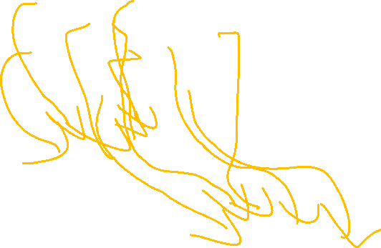
Convolution
20 | 20 | 45 | 200
18 | 20 | 125 | 240
35 | 125 | 245 | 245
145 | 250 | 240 | 240
1 | 0 | 1
0 | 1 | 0
1 | 0 | 1
$$\text{20 + 45 + 20 + 35 + 245}$$ | $$20+200+125+125+245$$
… | …

Slide 25
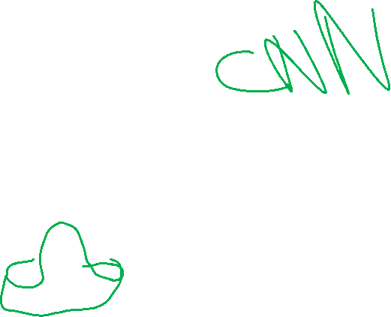
Convolution Matrices
Binary, e.g. diagonal Random
Intentional e.g. sombrero / hat
1 | 0 | 1
0 | 1 | 0
1 | 0 | 1
1 | -2 | 5
-3 | 1 | .4
-1.7 | -4 | 3
1 | 1 | 1
1 | -5 | 1
1 | 1 | 1

Slide 26
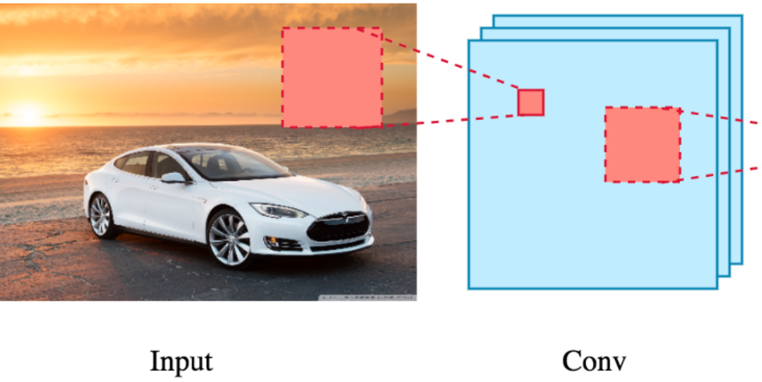
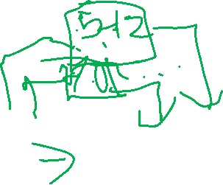
Data Convolution

Slide 27
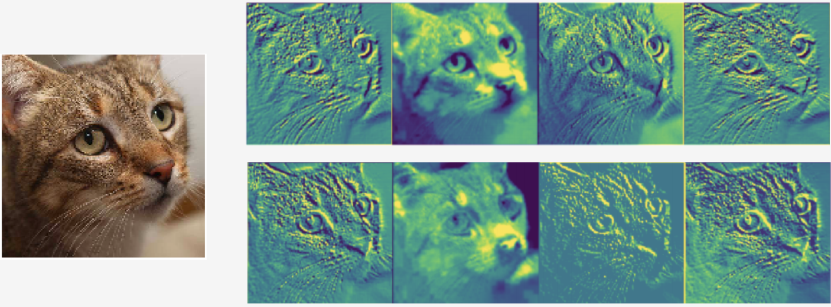
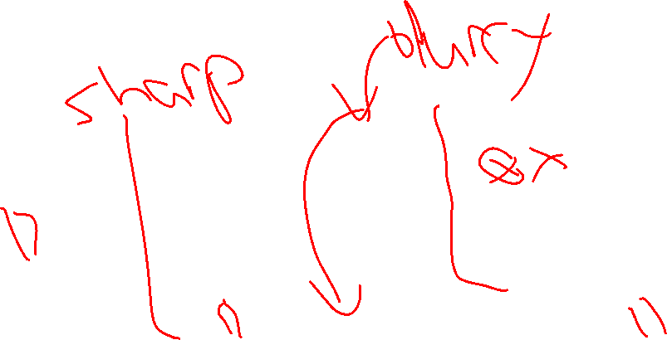
Data Convolution
First Layer Convolutions

Slide 28
Pooling
Reduce Complexity by combining neighboring terms
20 | 20 | 45 | 200
18 | 20 | 125 | 240
35 | 125 | 245 | 245
145 | 250 | 240 | 240

Slide 29
Pooling
Reduce Complexity by combining neighboring terms
e.g. max pool
20 | 20 | 45 | 200
18 | 20 | 125 | 240
35 | 125 | 245 | 245
145 | 250 | 240 | 240
20 | 240
250 | 245

Slide 30
Pooling
Reduce Complexity by combining neighboring terms
e.g. max pool
Downsamples the image (to reduce complexity)
Allow neighboring features to interact (grow downstream receptive fields)
20 | 20 | 45 | 200
18 | 20 | 125 | 240
35 | 125 | 245 | 245
145 | 250 | 240 | 240
20 | 240
250 | 245

Slide 31
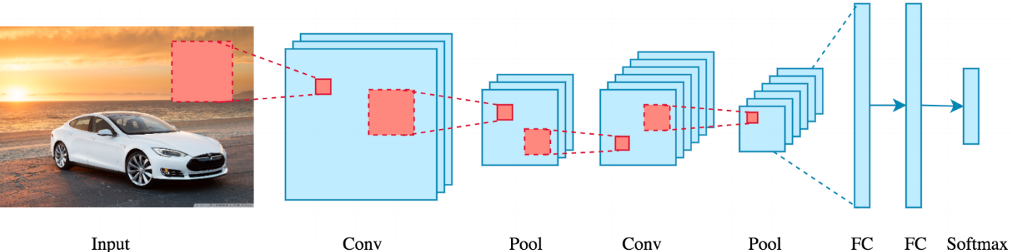
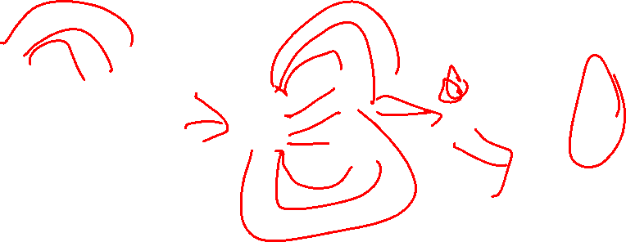
Convolution + Pooling

Slide 32
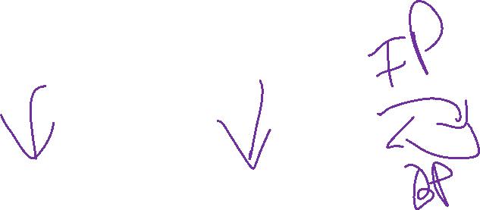
Improving Convolutions
SGD with Back Propagation
Details of implementation are beyond this course

Slide 33
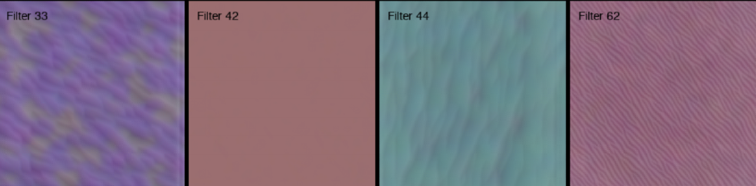

Convolution + Pooling – Multiple Iterations
Convolution Layer 1

Slide 34
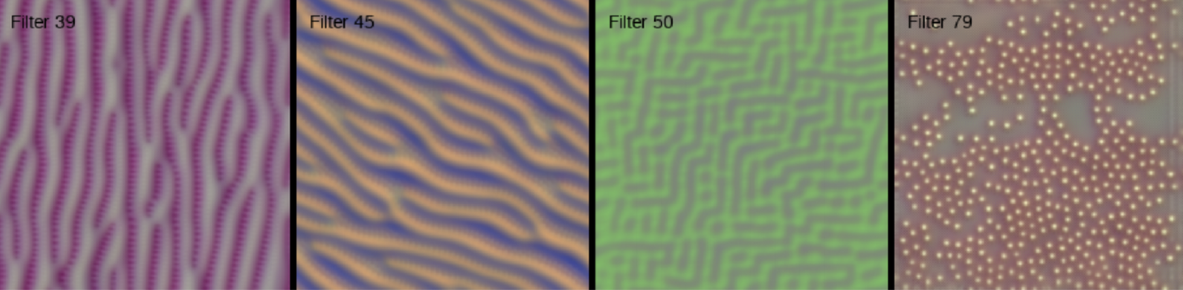
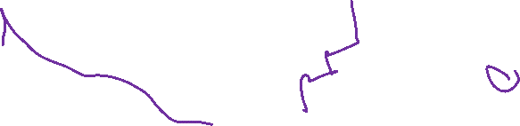
Convolution + Pooling – Multiple Iterations
Convolution Layer 2

Slide 35
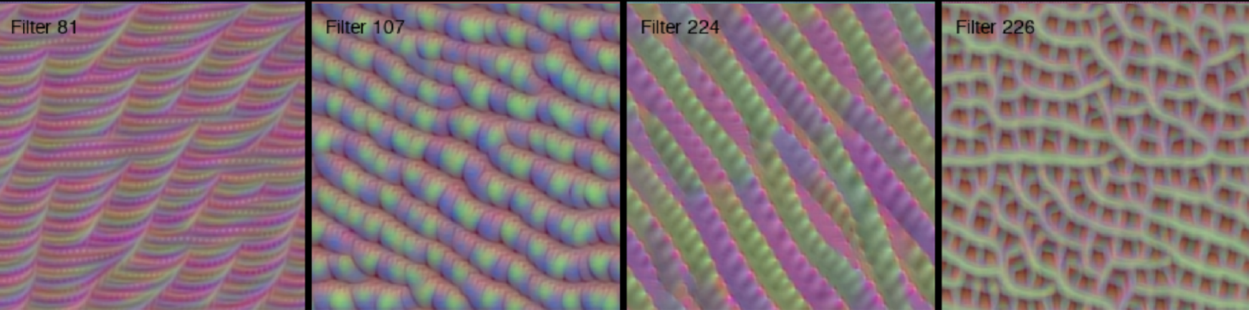

Convolution + Pooling – Multiple Iterations
Convolution Layer 3

Slide 36
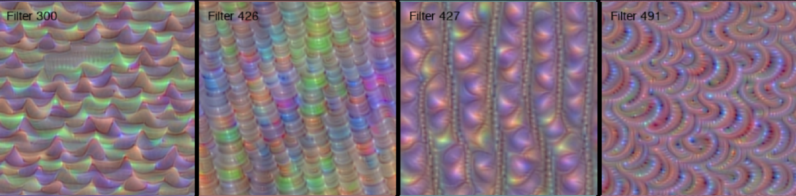
Convolution + Pooling – Multiple Iterations
Convolution Layer 4

Slide 37
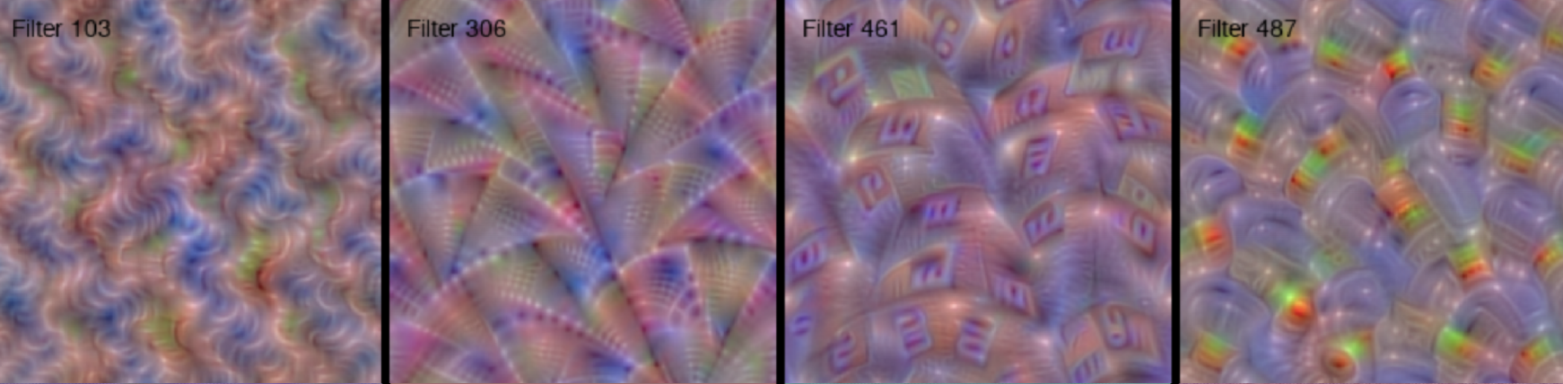
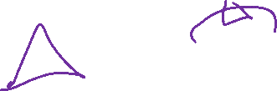
Convolution + Pooling – Multiple Iterations
Convolution Layer 5

Slide 38
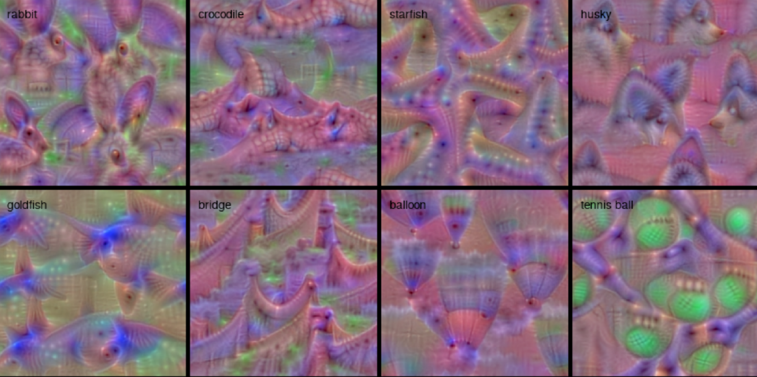
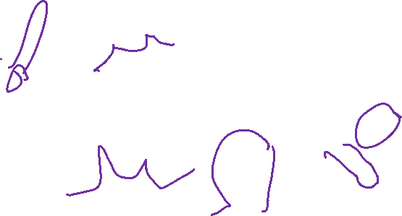
Convolution + Pooling – Multiple Iterations
Convolution Results

Slide 39
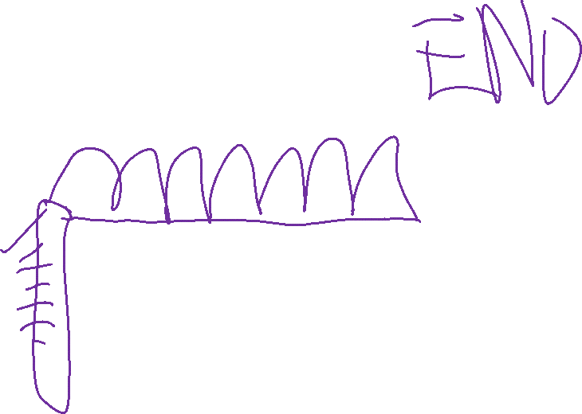
Convolutional Neural Network
Captures grid structure – retains it through layers

Slide 40
Friday

Slide 41
Course Logistics
Problem Set 3: 3/14 3/16 @ 11:59PM
Project Milestone 3: Due 4/8
Just a check-in, integrating feedback, etc.
Exam 1: Feedback process occurring…
Spring Break…

Slide 42
Participation – Problem Set 4

Slide 43
Neural Network – Object Recognition

Slide 44
Convolution
20 | 20 | 45 | 200
18 | 20 | 125 | 240
35 | 125 | 245 | 245
145 | 250 | 240 | 240
1 | 0 | 1
0 | 1 | 0
1 | 0 | 1
$$\text{20 + 45 + 20 + 35 + 245}$$ | $$20+200+125+125+245$$
… | …

Slide 45

Improving Convolutions
SGD with Back Propagation
Details of implementation are beyond this course

Slide 46
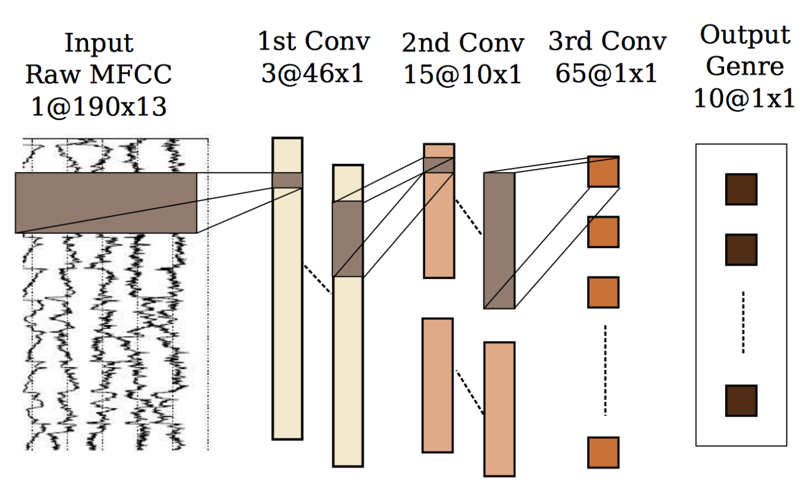
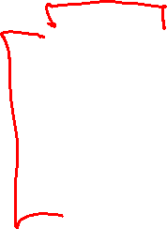
CNNs - Applications
Music – Genre Prediction

Slide 47
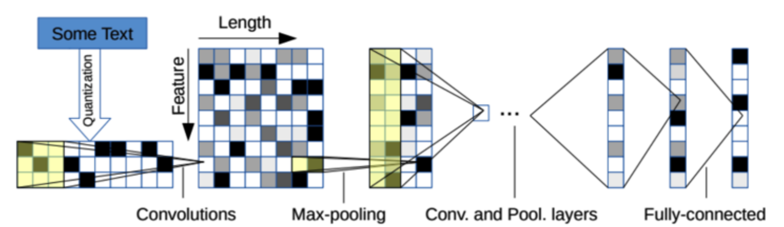
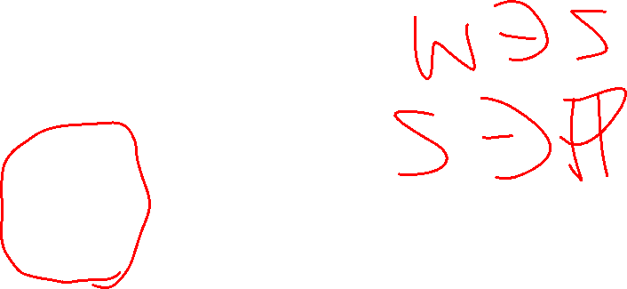
CNNs - Applications
NLP – Sentence Classification

Slide 48
More Complex Analysis
Useful Information for PS3 and PS4

Slide 49
Normalization with Splits
Train Data
Hold-Out Data
How should we work through scaling and / or normalization
with splits?
Test Data

Slide 50

Normalization with Splits
Train Data
Hold-Out Data
Test Data
What are these data splits really modeling?
Training Set:
Test Set:
Hold-Out (inner validation) Set:

Slide 51

Normalization with Splits
Train Data
Hold-Out Data
Test Data
What are these data splits really modeling?
Training Set: The data we have seen before – things we can train on.
Test Set: The data we have never seen before – things we have no way of knowing, and therefore no way of training on.
Hold-Out (inner validation) Set: Things we are treating like a Test set for internal validation processes (optimizing tuning parameters, etc.)

Slide 52
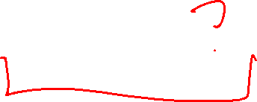
Normalization with Splits
Train Data
Hold-Out Data
Test Data
Which pieces can we use to set our parameters for normalization?

Slide 53

Normalization with Splits
Train Data
Hold-Out Data
Test Data
Which pieces can we use to set our parameters for normalization?
Only the training set!

Slide 54
Normalization with Splits
Train Data
Hold-Out Data
Test Data
Which pieces can we use to set our parameters for normalization?
Only the training set!
How are we going to transform our Hold-Out Data and Test Data so that they are normalized to look like our Train Data?

Slide 55
Normalization with Splits
Train Data
Hold-Out Data
Test Data
Which pieces can we use to set our parameters for normalization?
Only the training set!
How are we going to transform our Hold-Out Data and Test Data so that they are normalized to look like our Train Data?
Only by using the parameters of our training set normalization!

Slide 56
Recurrent Neural Networks

Slide 57
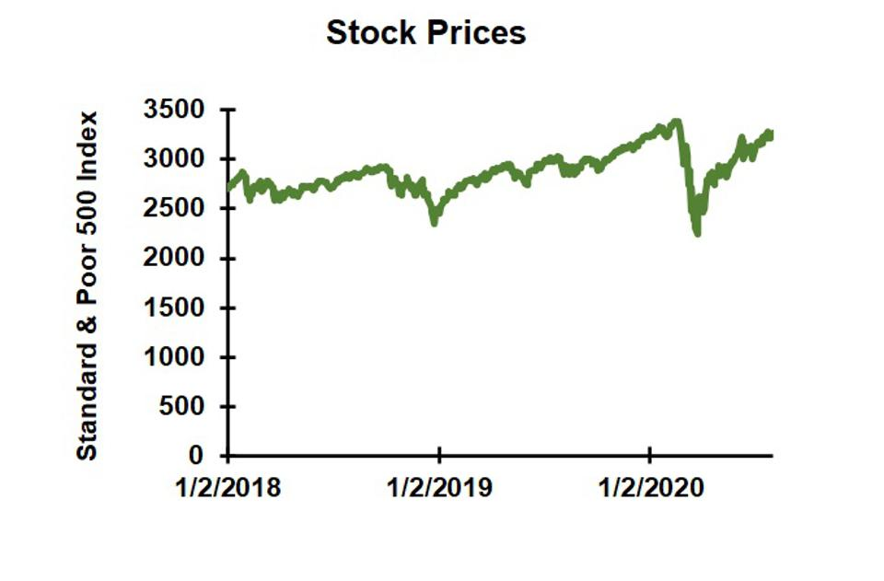
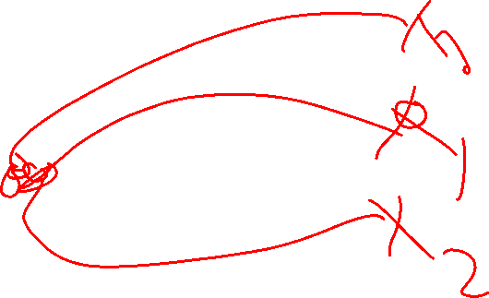
The Limits of Neural Networks

Slide 58
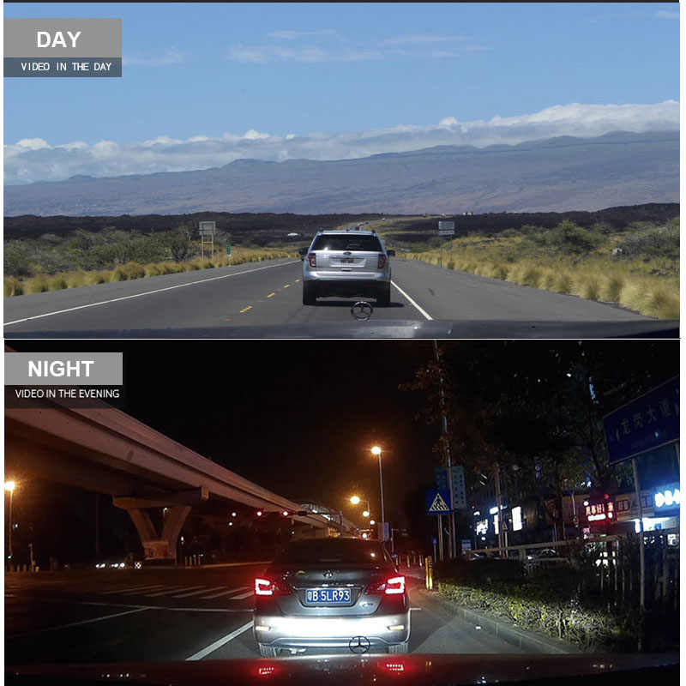
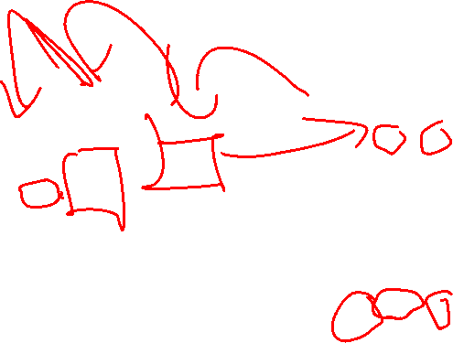
The Limits of Neural Networks
Notes:
https://ae01.alicdn.com/kf/H1d680fbff577471e8c928928f4e98280w/HGDO-H20-10-inch-Touch-screen-Car-DVR-Rear-View-Mirror-Dash-cam-Full-HD-Car.jpg_q50.jpg

Slide 59
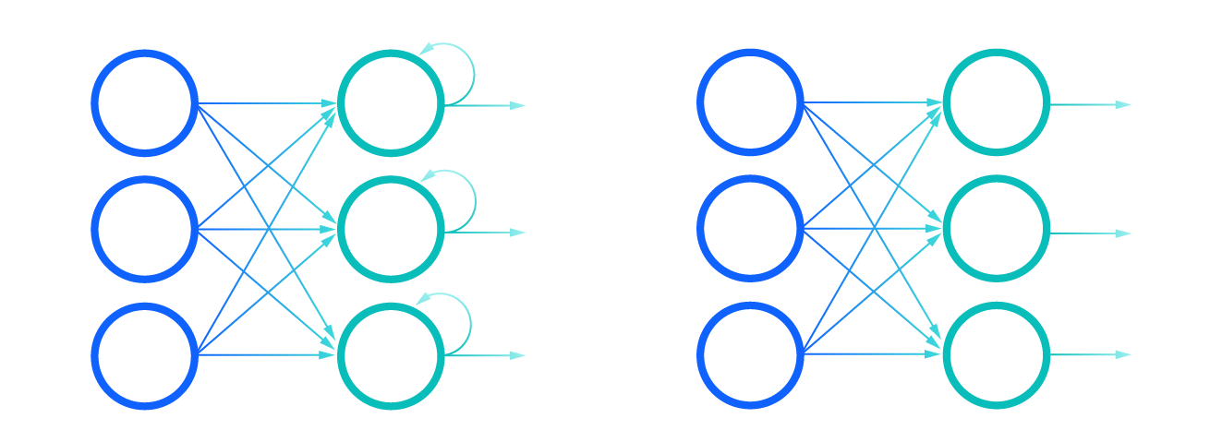
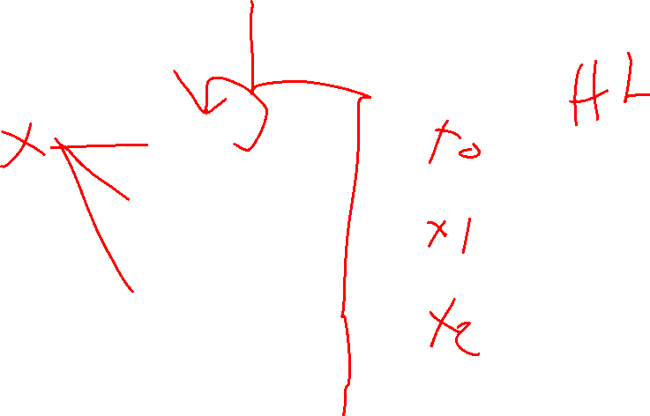
Recurrent NN vs. Feed-Forward (regular) NN

Slide 60
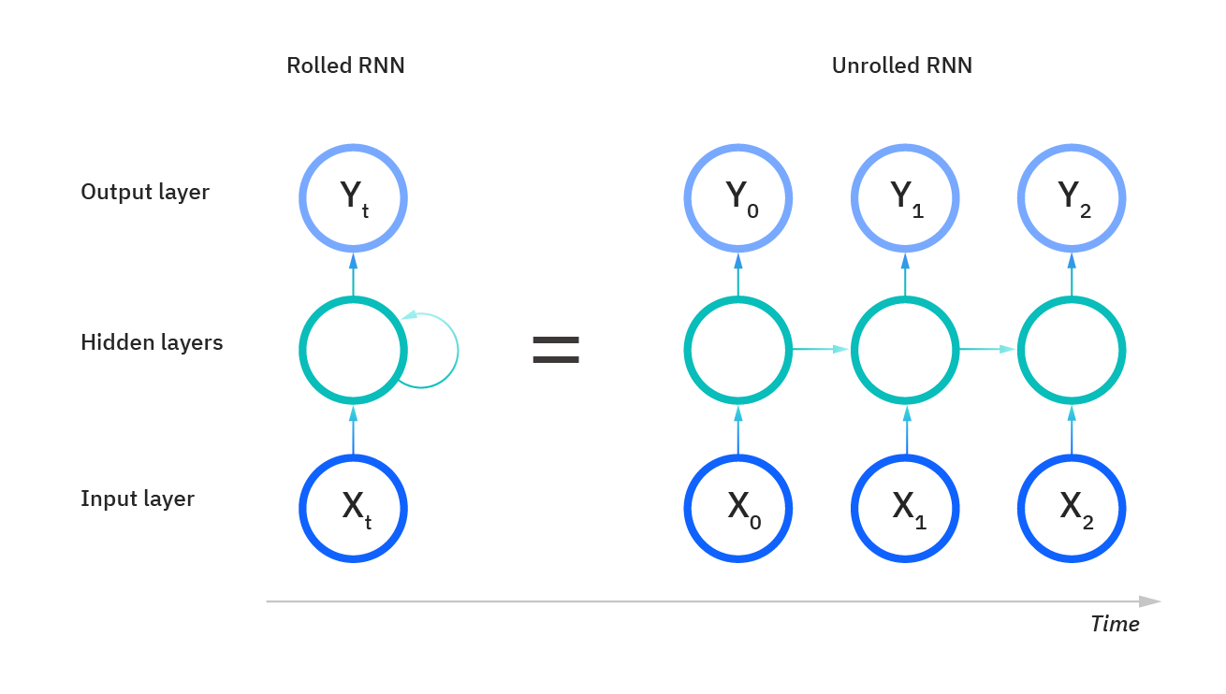
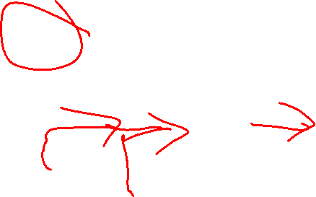
What’s Going On Here?

Slide 61
What’s Going On Here?
A Regular FF Neural Net
1
1
Y₁
X₁
Y₂
X₂

Slide 62
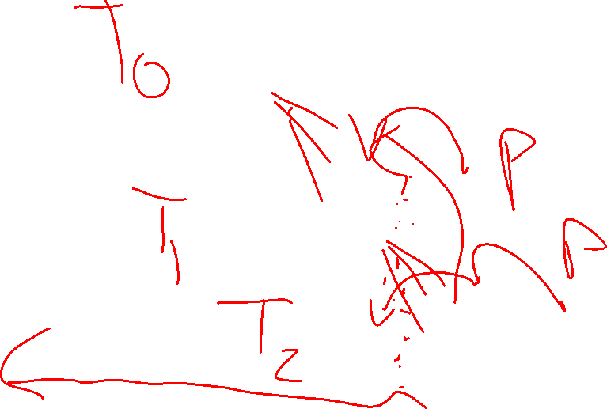
What’s Going On Here?
1
1
1
1
1
1

Slide 63
Wait… Why “LSTM” Layer?
1
1
We have LOTS of weights…
https://neptune.ai/blog/understanding-gradient-clipping-and-how-it-can-fix-exploding-gradients-problem
1
1
1
1

Slide 64
Wait… Why “LSTM” Layer?
1
1
We have LOTS of weights…
Each weight has a diminishing ability to impact
https://neptune.ai/blog/understanding-gradient-clipping-and-how-it-can-fix-exploding-gradients-problem
1
1
1
1

Slide 65
Wait… Why “LSTM” Layer?
1
1
We have LOTS of weights…
Each weight has a diminishing ability to impact
We have LOTS of layers!
https://neptune.ai/blog/understanding-gradient-clipping-and-how-it-can-fix-exploding-gradients-problem
1
1
1
1

Slide 66
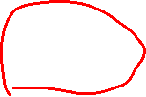
Wait… Why “LSTM” Layer?
1
1
We have LOTS of weights…
Each weight has a diminishing ability to impact
We have LOTS of layers!
These layers are dependent
We cannot rely on intermediate steps for backpropogation…
Either “Vanishing” or “Exploding” gradients
https://neptune.ai/blog/understanding-gradient-clipping-and-how-it-can-fix-exploding-gradients-problem
1
1
1
1

Slide 67
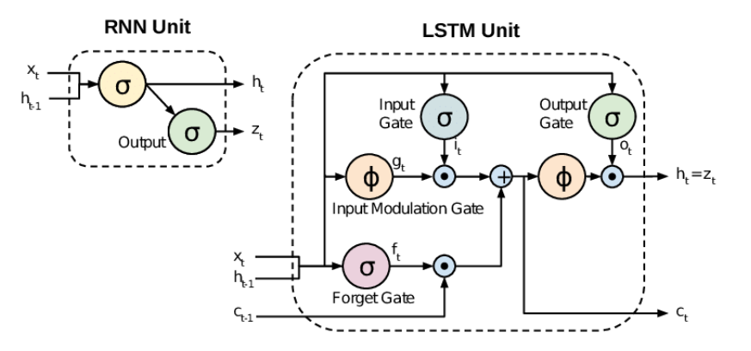
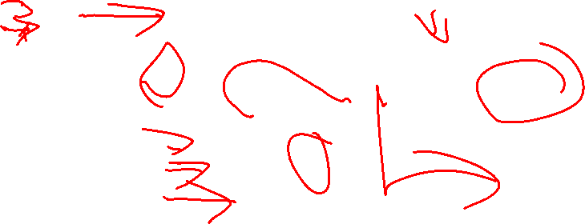
RNN vs. LSTM

Slide 68
Reinforcement Learning
How to learn everything in one lecture*

Slide 69
Reinforcement Learning in One Class
IMPOSSIBLE!
There are books on the subject
- Reinforcement Learning: An Introduction – Sutton & Barto
- http://incompleteideas.net/book/the-book.html

Slide 70
Our Typical ML Models
Fitting our Model to Training Data
- Fitting Decision Boundary
- Finding weights, biases, etc.
- Finding Similar Examples

Slide 71
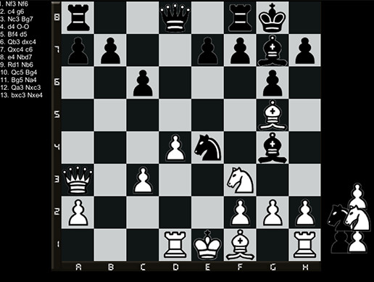
A Different Kind of Problem…
Notes:
https://assetstorev1-prd-cdn.unity3d.com/key-image/3887a860-dbac-447f-8358-732a955e0e19.jpg

Slide 72


A Different Kind of Problem…
Notes:
http://incompleteideas.net/book/bookdraft2017nov5.pdf

Slide 73

A Different Kind of Problem…
Complex decisions
Multi-step activity
steps are not independent
Multiple (Opposing) Players
Notes:
https://assetstorev1-prd-cdn.unity3d.com/key-image/3887a860-dbac-447f-8358-732a955e0e19.jpg

Slide 74
Examples of this Problem
Games – board (chess, go, others), video (adventure, strategy, others)
Stock Investing
Autonomous Vehicles
Others…

Slide 75
Defining Our Problem Space
Agent – A decision-making entity

Slide 76
Defining Our Problem Space
Agent – A decision-making entity
Environment – The space in which the Agent is making decisions

Slide 77
Defining Our Problem Space
Agent – A decision-making entity
Environment – The space in which the Agent is making decisions
State – The current status of the Environment

Slide 78
Defining Our Problem Space
Agent – A decision-making entity
Environment – The space in which the Agent is making decisions
State – The current status of the Environment
Goal – An eventual outcome sought by the Agent

Slide 79
Defining Our Problem Space
Agent – A decision-making entity
Environment – The space in which the Agent is making decisions
State – The current status of the Environment
Goal – An eventual outcome sought by the Agent
Reward – An intermediate measure of success / failure towards the Goal

Slide 80

Defining Our Problem Space
Agent – A decision-making entity
Environment – The space in which the Agent is making decisions
State (S) – The current status of the Environment
Goal – An eventual outcome sought by the Agent
Reward (R) – Intermediate measure of success/failure towards the Goal
Action (A) – The options available to the Agent to change the State

Slide 81

Action & State are Linked
What’s possible? vs
What’s effective?

Slide 82


Markov Decision Processes
Notes:
http://incompleteideas.net/book/bookdraft2017nov5.pdf

Slide 83


Markov Decision Process

Slide 84
Action + State = Policy
Policy (π) – The mapping of state to action

Slide 85
Expanding Reward
Reward – An intermediate measure of success / failure towards the Goal

Slide 86

Expanding Reward
Reward – An intermediate measure of success / failure towards the Goal
Immediate & Future Rewards must both be considered

Slide 87
Expanding Reward
Reward – An intermediate measure of success / failure towards the Goal
Immediate & Future Rewards must both be considered
Value (V) – The expected long-term return based on an action from this current state

Slide 88

Expanding Reward
Reward – An intermediate measure of success / failure towards the Goal
Immediate & Future Rewards must both be considered
Value (V) – The expected long-term return of the current state (in terms of our policy π)
V(S) = Immediate Reward +
(Future Reward * Discount Factor)

Slide 89
Dealing with Value
A variety of factors can be given positive value
- distance to target

Slide 90
Dealing with Value
A variety of factors can be given positive value
- distance to target
- existing intermediate rewards
- chess: removing an enemy piece
- video game: coin, powerup

Slide 91
Dealing with Value
A variety of factors can be given negative value
- bad “goals”
- game over, putting yourself into checkmate

Slide 92
Dealing with Value
A variety of factors can be given negative value
- bad “goals”
- game over, putting yourself into checkmate
- bad intermediate moves
- losing a piece

Slide 93
Dealing with Value
A variety of factors can be given negative value
- bad “goals”
- game over, putting yourself into checkmate
- bad intermediate moves
- losing a piece
- effort
- any move can have cost

Slide 94

Dealing with Value
Black is considering two options
- Knight to F2
- Queen to D5
What happens if we value capturing pieces highly?
What happens if we avoid risk?

Slide 95

Dealing with Value
Black is considering two options
- Knight to F2
- Queen to D5
What happens if we value capturing pieces highly?
What happens if we avoid risk?
What happens 5 moves out???

